Slide 1
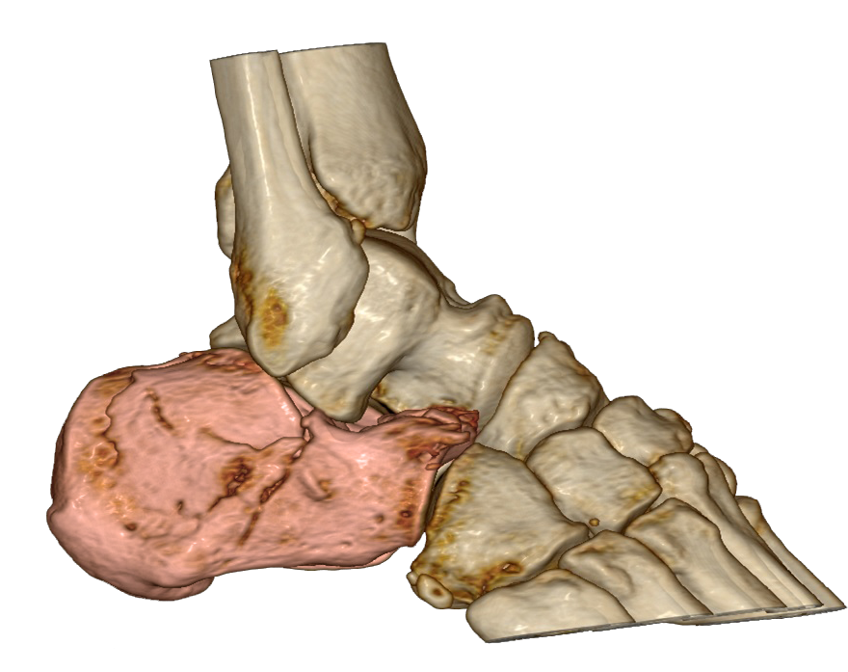
Case report showing the importance of extension for reduction
fracture situation
Essex-Lopresti
depression-type

Slide 2
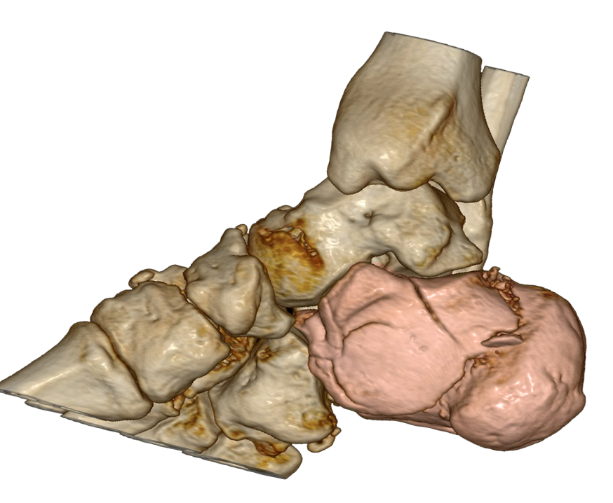
Case report showing the importance of extension for reduction
fracture situation
Essex-Lopresti
depression-type

Slide 3
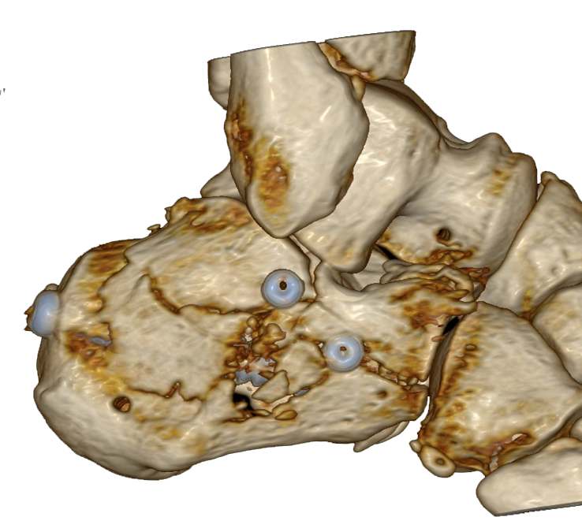
Case report showing the importance of extension for reduction
Outcome
surgery in
„minimal invasive
technique“
no good outcome

Slide 4
comparison
outcome
fracture

Slide 5
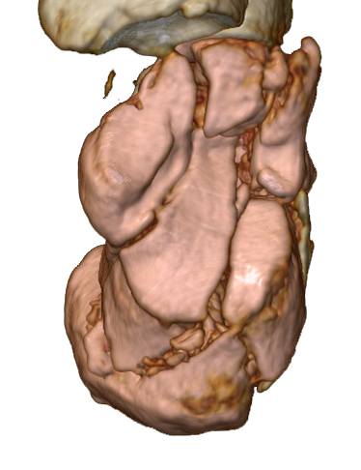
analysis
fracture situation
axial
medial

Slide 6
analysis
fracture situation
axial
lateral

Slide 7
comparison
outcome
fracture

Slide 8
analysis
outcome
fracture

Slide 9
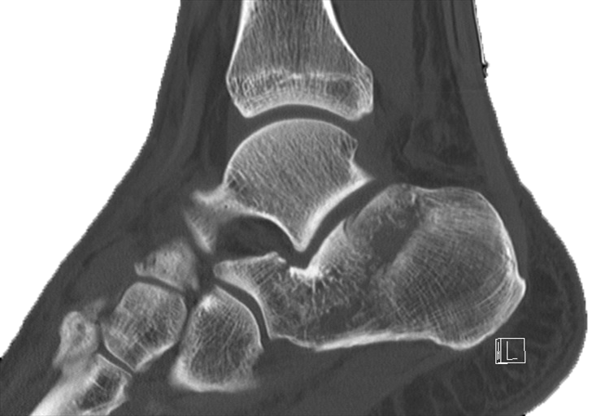
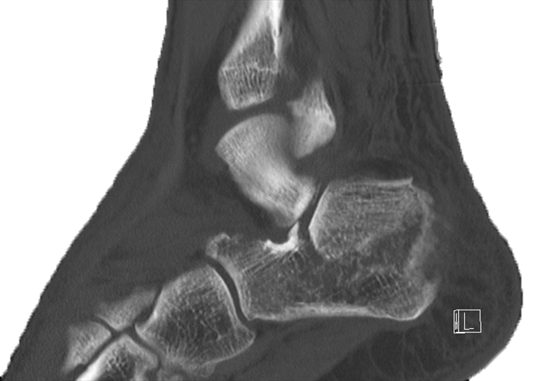
analysis
fracture

Slide 10
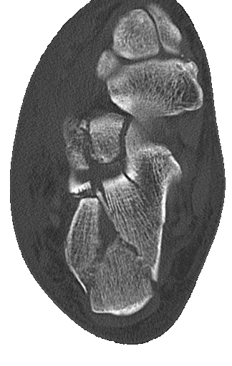
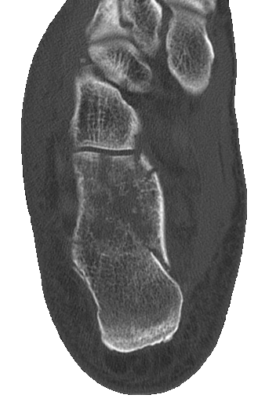
analysis

Slide 11
the surgeon used an extension device
outcome
fracture

Slide 12
but when you compare you see no change of lenght
outcome
fracture

Slide 13
but when you compare you see no change of lenght
outcome
fracture

Slide 14
as a consequence there is no space for the lateral joint fragment
outcome
fracture

Slide 15
as a consequence there is no space for the lateral joint fragment
outcome
fracture

Slide 16
anatomical reduction is not possible
outcome
fracture

Slide 17
anatomical reduction is not possible
outcome
fracture

Slide 18
he saw it on the X-ray views and tried it with a raspatory from lateral
outcome
fracture

Slide 19
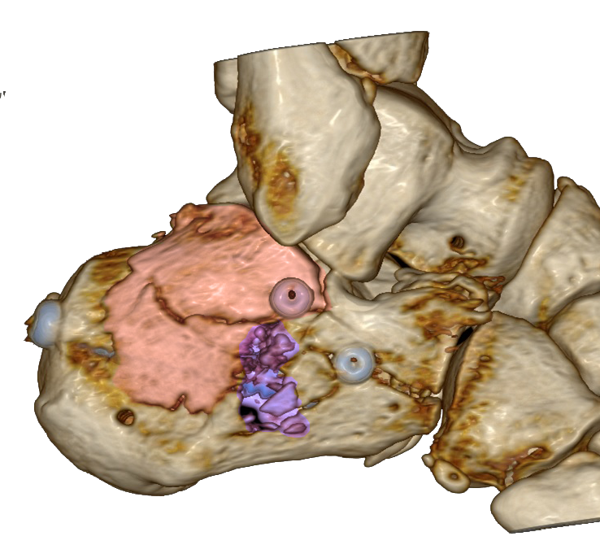
he saw it on the X-ray views and tried it with a raspatory from lateral
outcome
fracture

Slide 20
but some destruction
outcome
fracture

Slide 21
for the same reason reduction and fixation of the anterior part
was not succesful
outcome
fracture

Slide 22
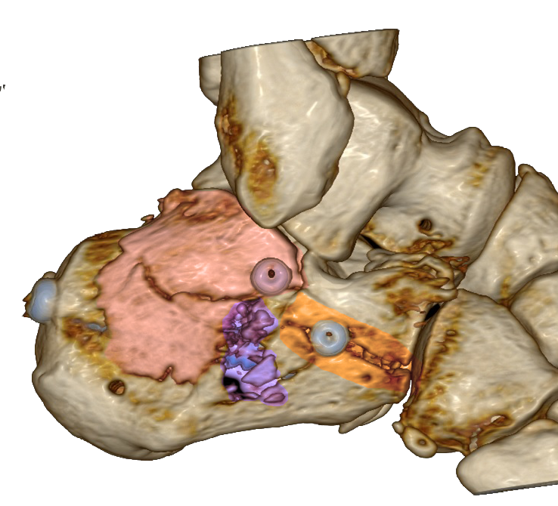
and by trying he broke the lateral wall
outcome
fracture

Slide 23
and by trying he broke the lateral wall
outcome
fracture

Slide 24
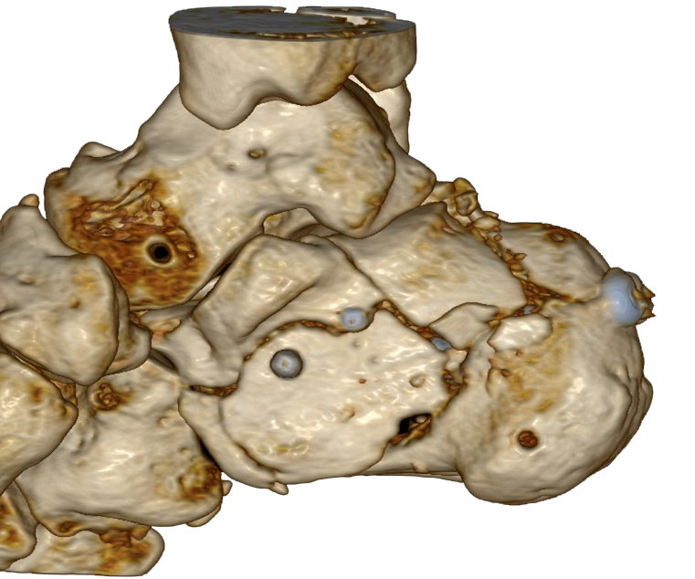
the position of the screws - especially the Sustentaculumscrew
is not good
outcome
fracture

Slide 25
you should try to place it about here
outcome
fracture

Slide 26
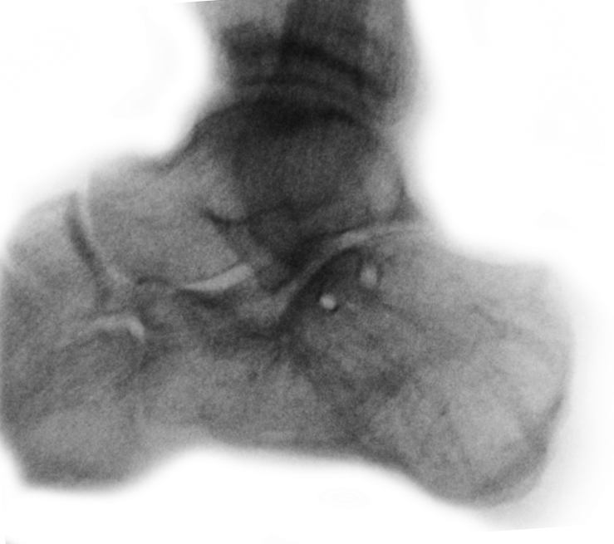
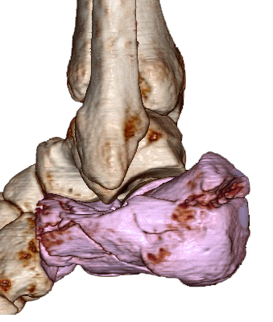
Thank you for your attention.
Christian Rodemund
Trauma center Linz
christian.rodemund@auva.at
Georg Mattiassich
Trauma center Graz
georg.mattiassich@auva.at
www.calcaneal-fracture.com
www.auva.at

Slide 27
www.calcaneal–fracture.com
visit us – join us

